Slide 1
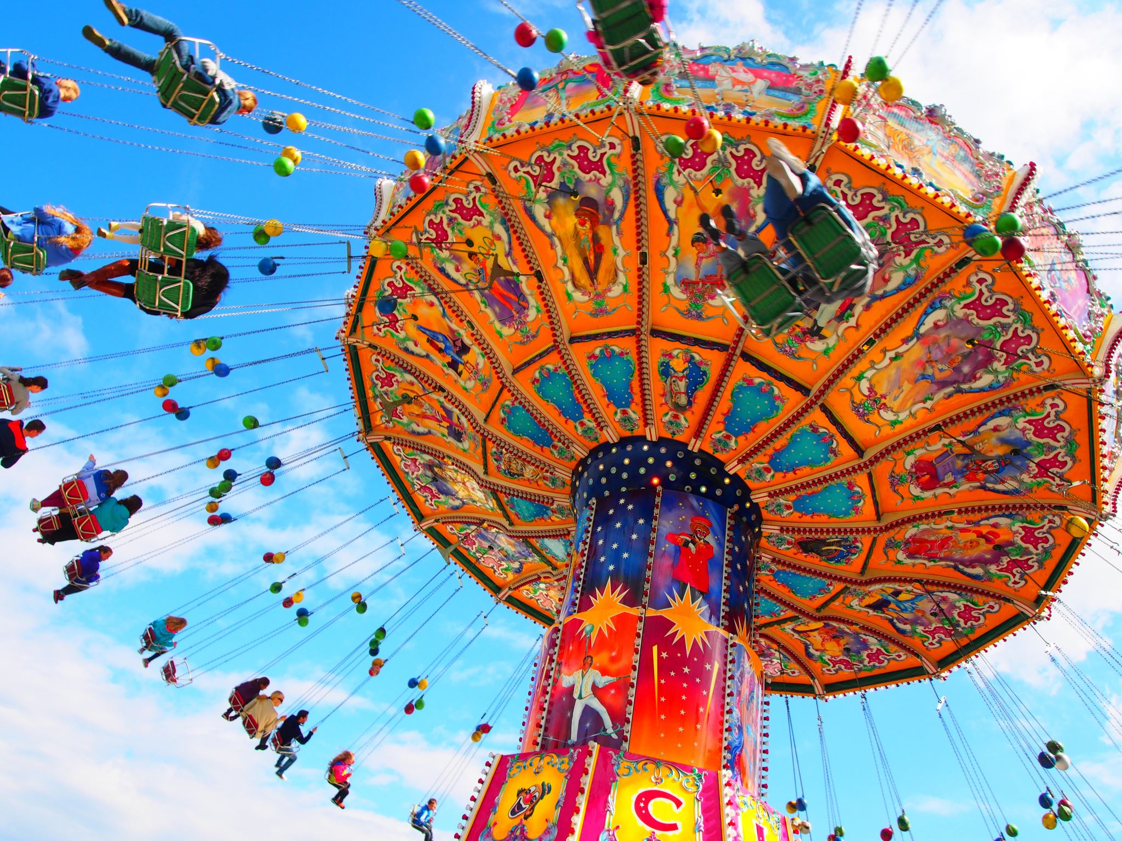
ADVENTURE Galaxy
By: Rahul Pala

Slide 2
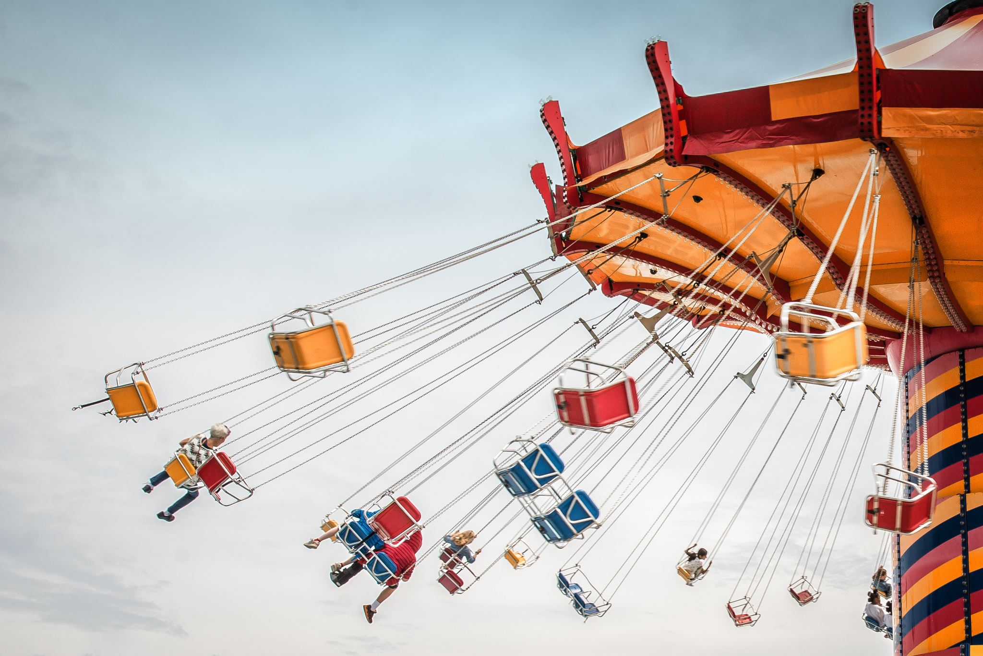
INTRODUCTION
.
Adventure Galaxy is a theme park website which provides rides and shows information in detail . Our website provides detailed information about all attractions. It allows visitors to make ride reservation and family service room reservation. Also, visitors can rate rides and shows as real-time adrenaline rating.

Slide 3
PURPOSE
Enhance Visitor Experience: By providing unique attractions and detailed ride information, visitors can plan their visits better and enjoy a more personalized experience.
1
Reduce Wait Times: Allowing riders to make ride reservations which allows them to explore more of the park and avoid waiting in long queues.
2
Improve Family Convenience: Offering reservable family service rooms to ensure that families have the necessary facilities to take care of their children.
3
Increase Ride Transparency: To provide Real-time adrenaline ratings and clear height restrictions which helps visitors make informed decisions about which rides to go on, enhancing safety and enjoyment.
4

Slide 4

Why address this problem?
Reduced Wait Times: Long wait times are a significant pain point for theme park visitors. By offering ride reservation system and family room reservation system, visitors can enjoy more attractions instead of standing in line.
Unique Selling Points/Competitive advantage: Features like ride reservation and family room reservation system set Adventure Galaxy theme park apart from competitors, gaining competitive advantage and making it more attractive to potential visitors.
Leveraging Technology for Efficiency:
3. Operational Efficiency: Real-time updates and virtual queue management streamline park operations, helping to manage crowds more effectively and reducing the strain on staff.
4. Informed Decisions: Real-time adrenaline ratings provide up-to-date feedback on rides, helping visitors make informed decisions based on the most current experiences of other visitors.

Slide 5
Current vs Desired State?
Current state
Desired state
Long Wait Times
No Reservation System: Visitors must physically stand in line for rides, which can be tiring and time-consuming.
Limited Family Facilities: Theme parks may have family service rooms, but the ability to reserve them online is typically unavailable, making it inconvenient for parents.
Inconsistent Ride Ratings: Ride ratings are often static and do not reflect real-time visitor experiences, leading to potential mismatches in expectations.
Reduced Wait Times: Visitors experience shorter wait times due to the availability of real-time wait times and virtual queue management.
Ride Reservation System: Visitors can reserve a spot in line via the website and receive notifications when it’s their turn to ride, eliminating the need to physically stand in line.
Convenient Family Facilities: Parents can reserve family service rooms online, ensuring they have a convenient and private space to take care of their children’s needs.
Real-Time Adrenaline Ratings: Visitors can rate rides in real-time, providing current and relevant feedback to help others make informed decisions.

Slide 6
Who does it ?
Walt Disney World: Visitors can use the Genie+ and Lightning Lane systems to reserve access to rides.
Universal Orlando Resort: The Universal Express Pass allows visitors to skip the regular lines at most attractions.
Most Theme parks around the world do not allow riders to make online ride reservation.
Most theme parks do not allow visitors to make online family room reservation.

Slide 7
Industry/domain
The industry in focus is the theme park and amusement park industry, which includes various entertainment attractions such as rides, shows, and themed areas designed to provide recreational experiences to visitors.

Slide 8
Key Concepts in the Industry
Visitor Experience: The overall satisfaction of visitors, influenced by factors like wait times, attractions, amenities, and customer service.
Queue Management: Strategies to manage and reduce wait times for attractions, improving visitor flow and satisfaction.
Real-Time Information: Providing up-to-date information on wait times, ride statuses, and park events.
Family-Friendly Services: Amenities and services tailored to families, such as childcare facilities and family-friendly attractions.
Safety and Regulations: Ensuring all attractions meet safety standards and regulations to protect visitors.
Technological Innovation: Using technology to enhance the visitor experience and streamline operations.

Slide 9

Stakeholders
Theme Park Visitors-
Expectations: Accurate real-time information, ease of use, reduced wait times, and enhanced overall park experience.
Theme Park Management and Staff
Expectations: Reliable system performance, ease of managing and updating information, insightful analytics, and positive visitor feedback.
Ride Operators and Maintenance Staff
Expectations: Accurate and timely updates, ease of reporting and managing ride statuses, and reduced operational disruptions.
IT and Support Teams
Expectations: Robust and secure software, ease of maintenance, and prompt resolution of any technical issues.
Marketing and Sales Teams
Expectations: Insightful analytics, positive visitor reviews and feedback, and increased visitor engagement and satisfaction.

Slide 10

PRODUCT DESCRIPTION

Slide 11
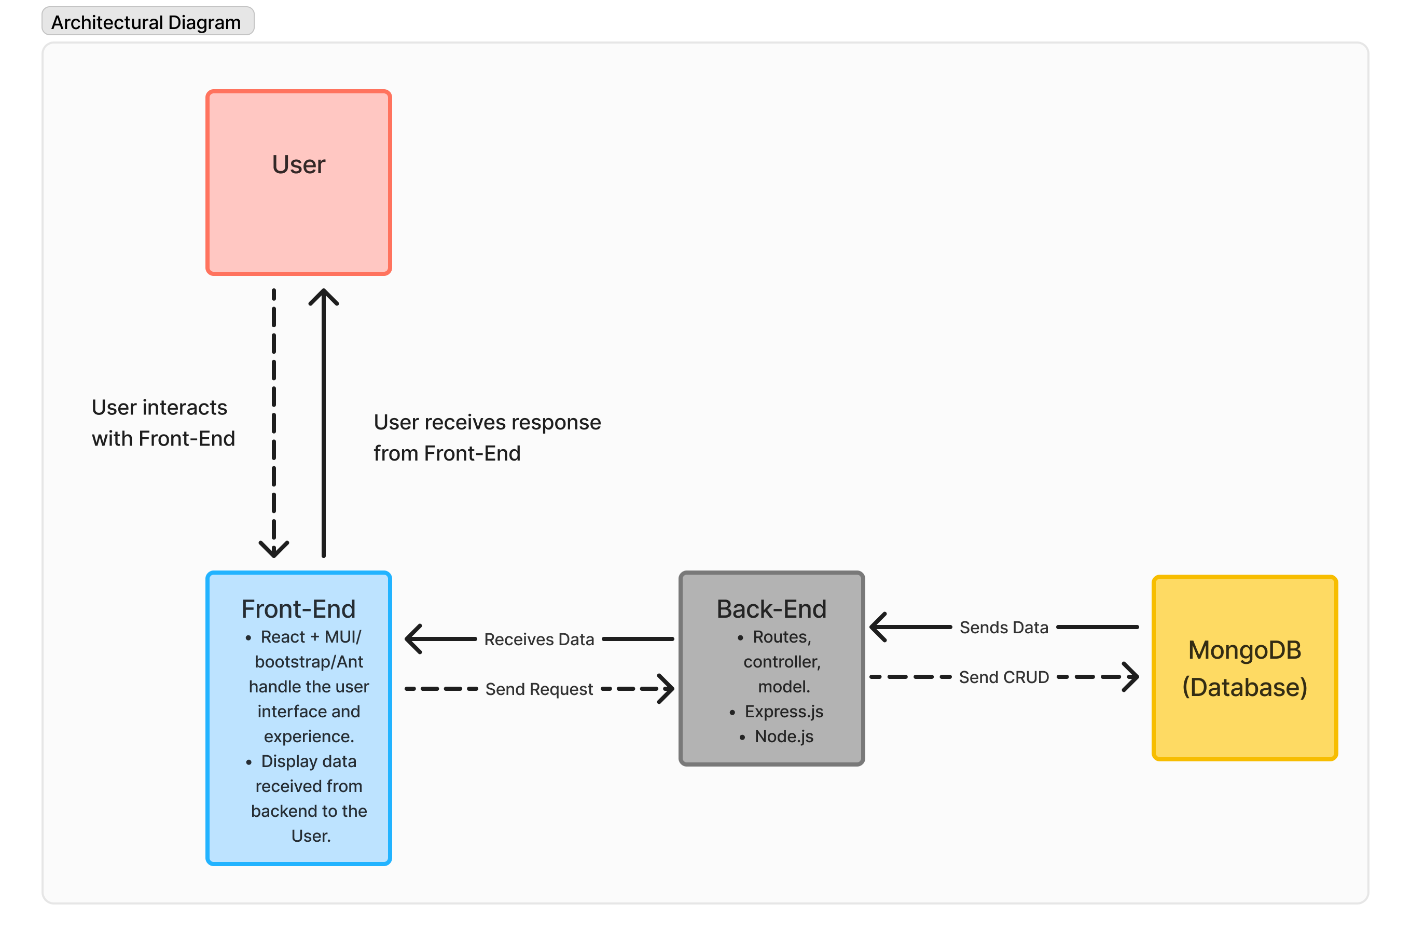
Architectural diagram

Slide 12
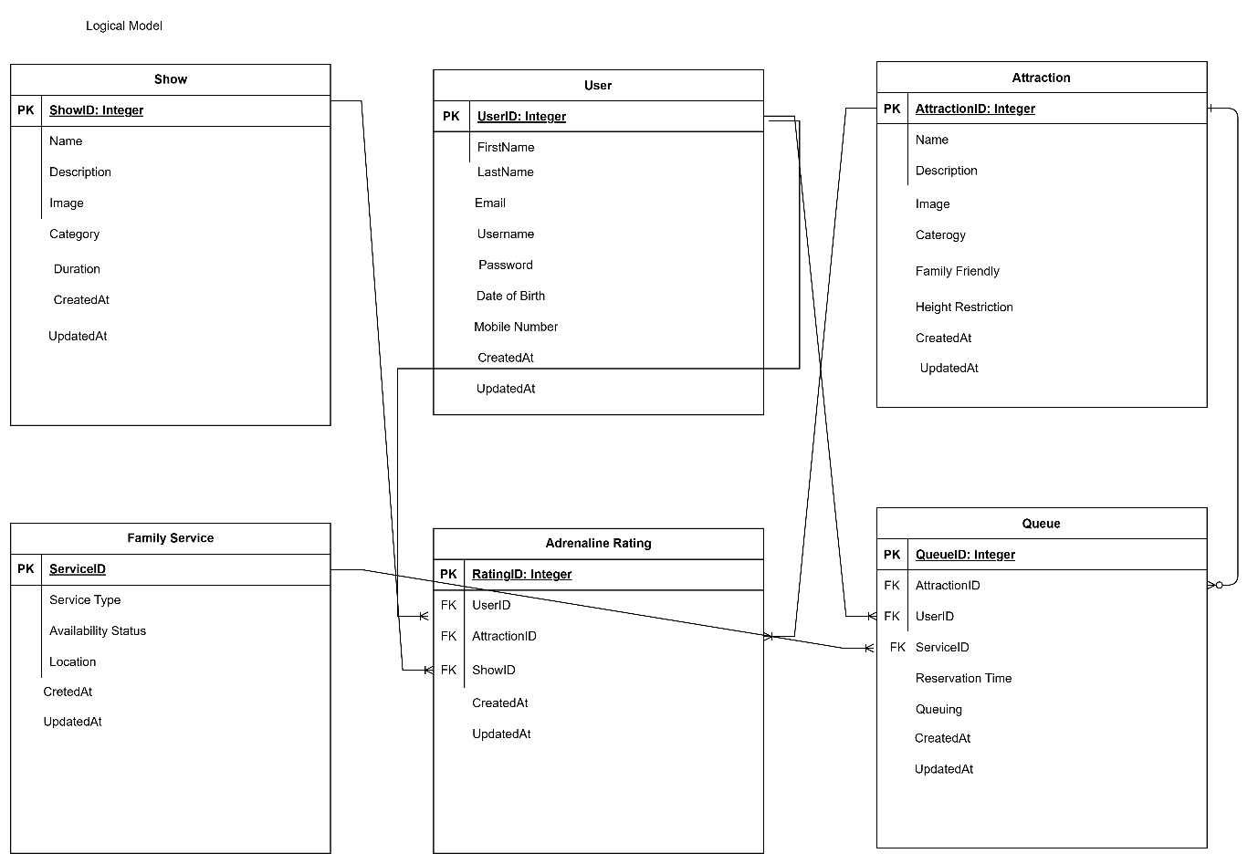

Slide 13
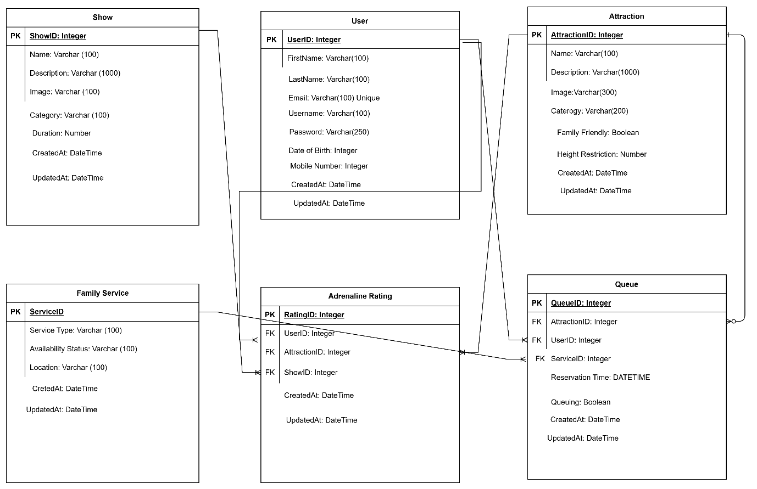

Slide 14
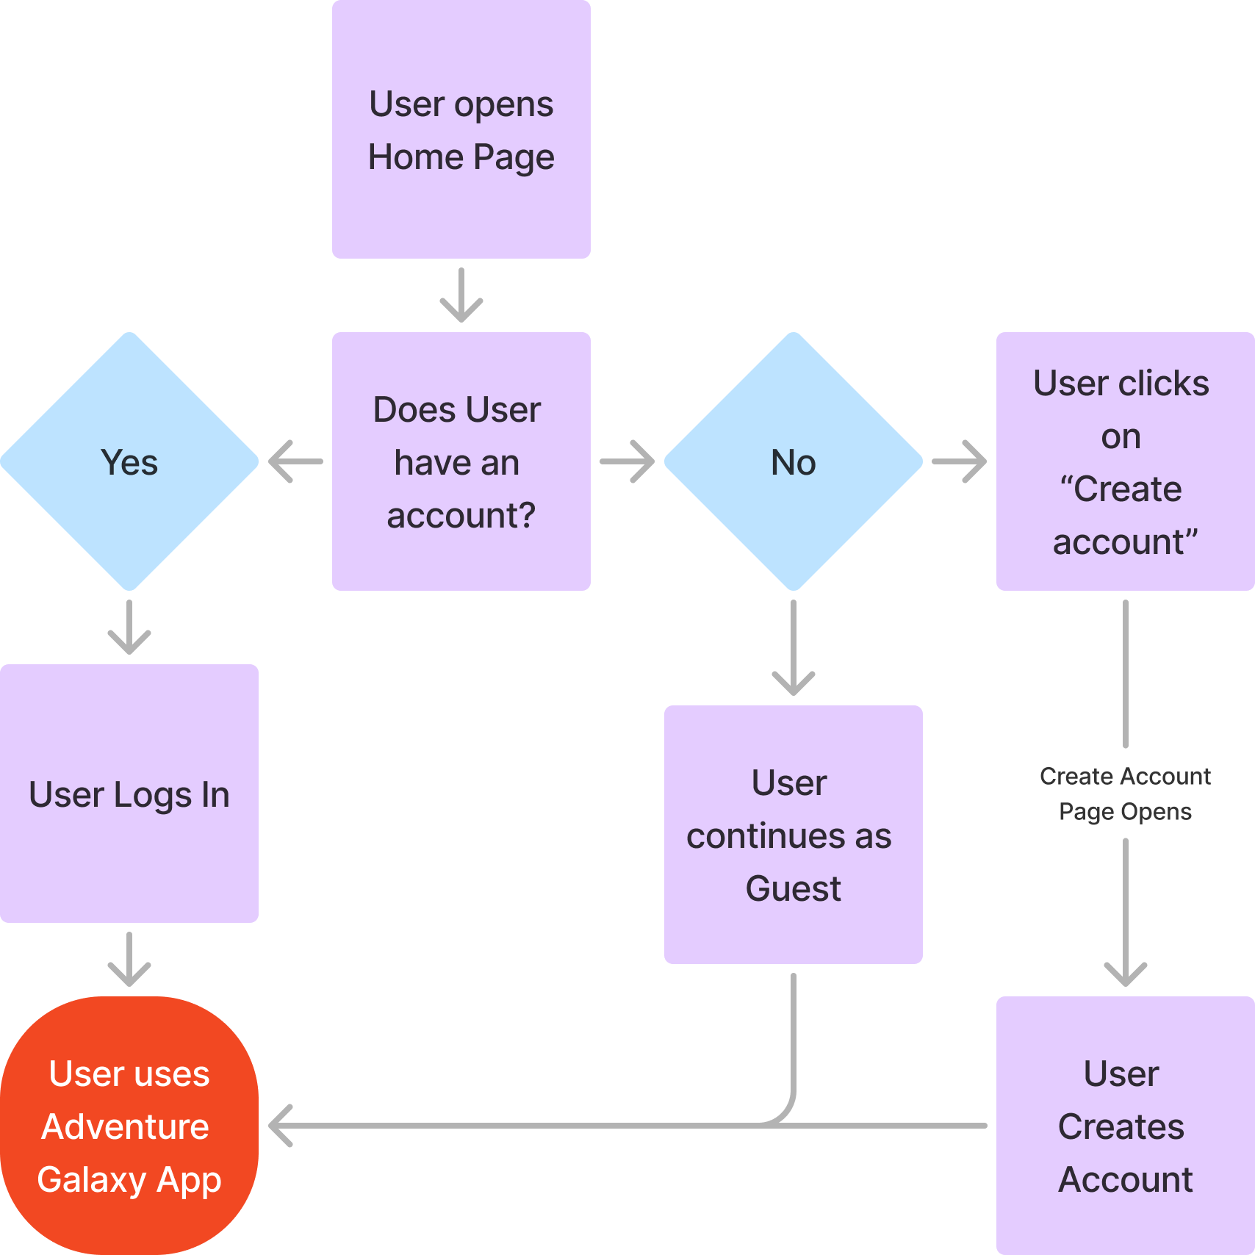
Flow diagram
Home Page

Slide 15
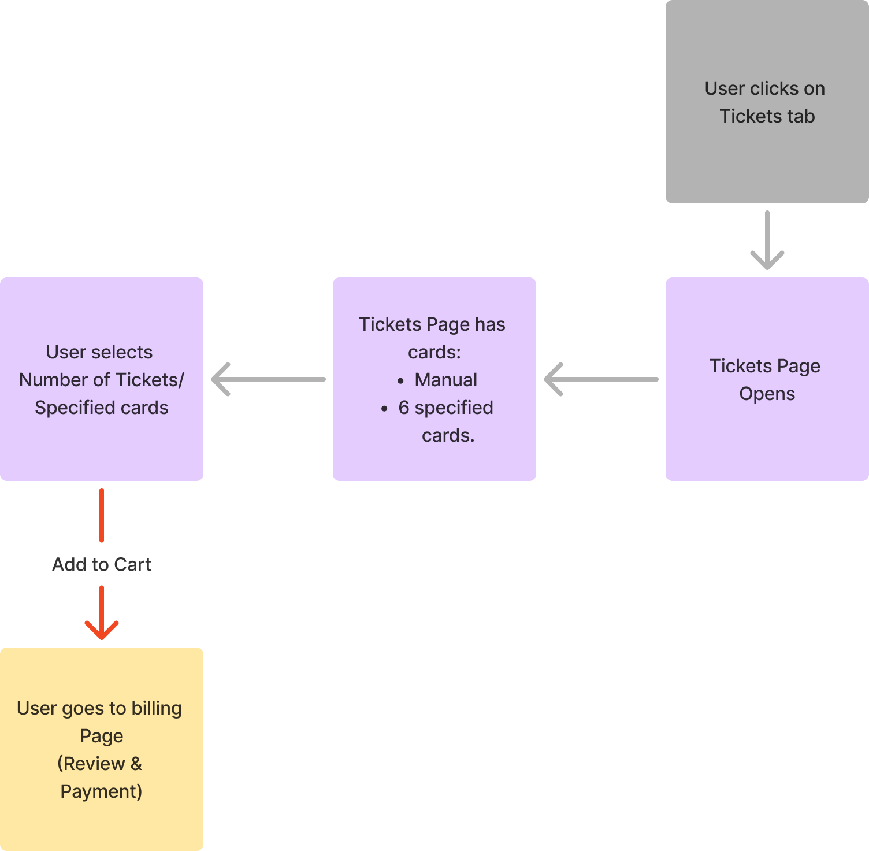
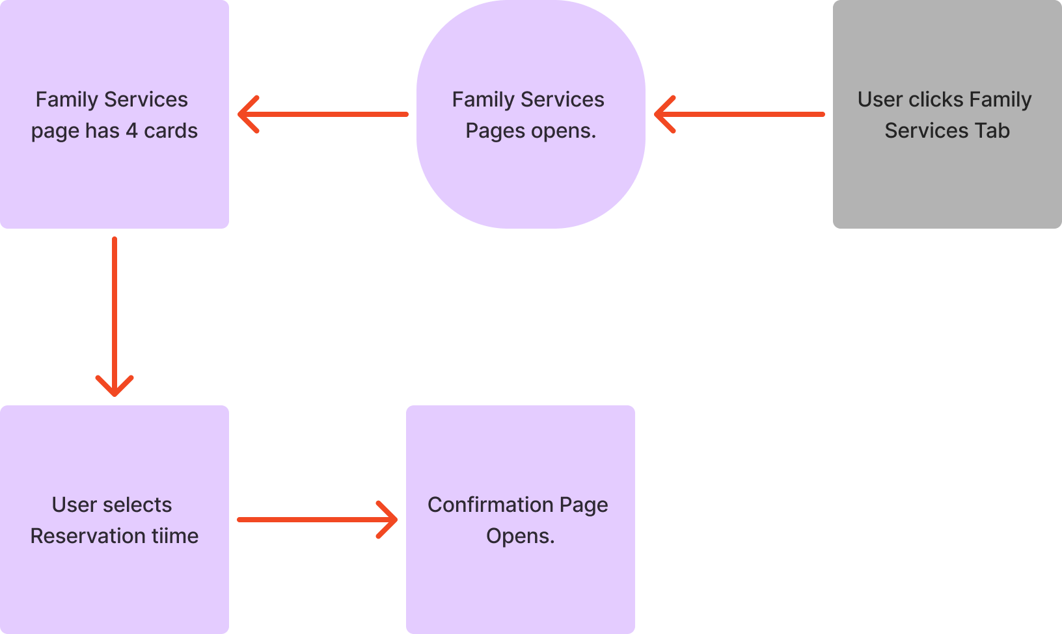
User flow
Tickets Page
Family Services Page

Slide 16
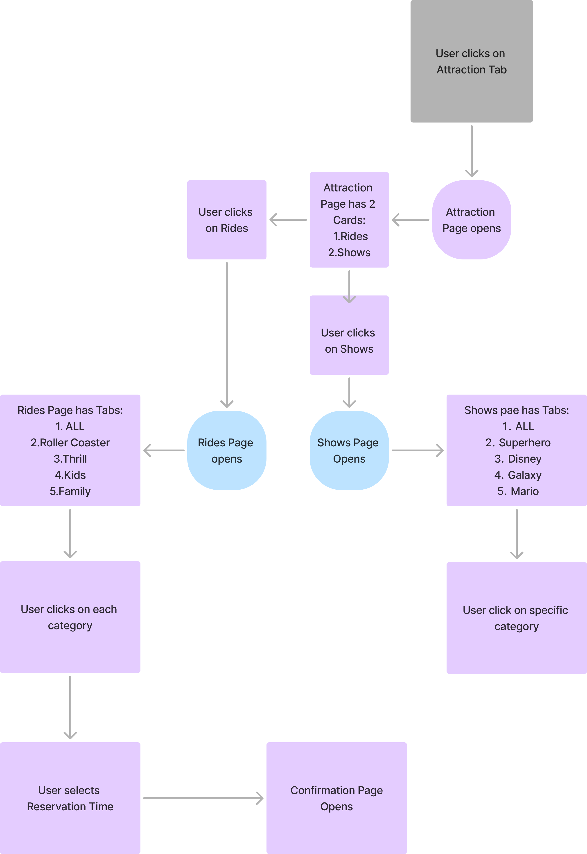
Flow diagram
Attractions Page

Slide 17
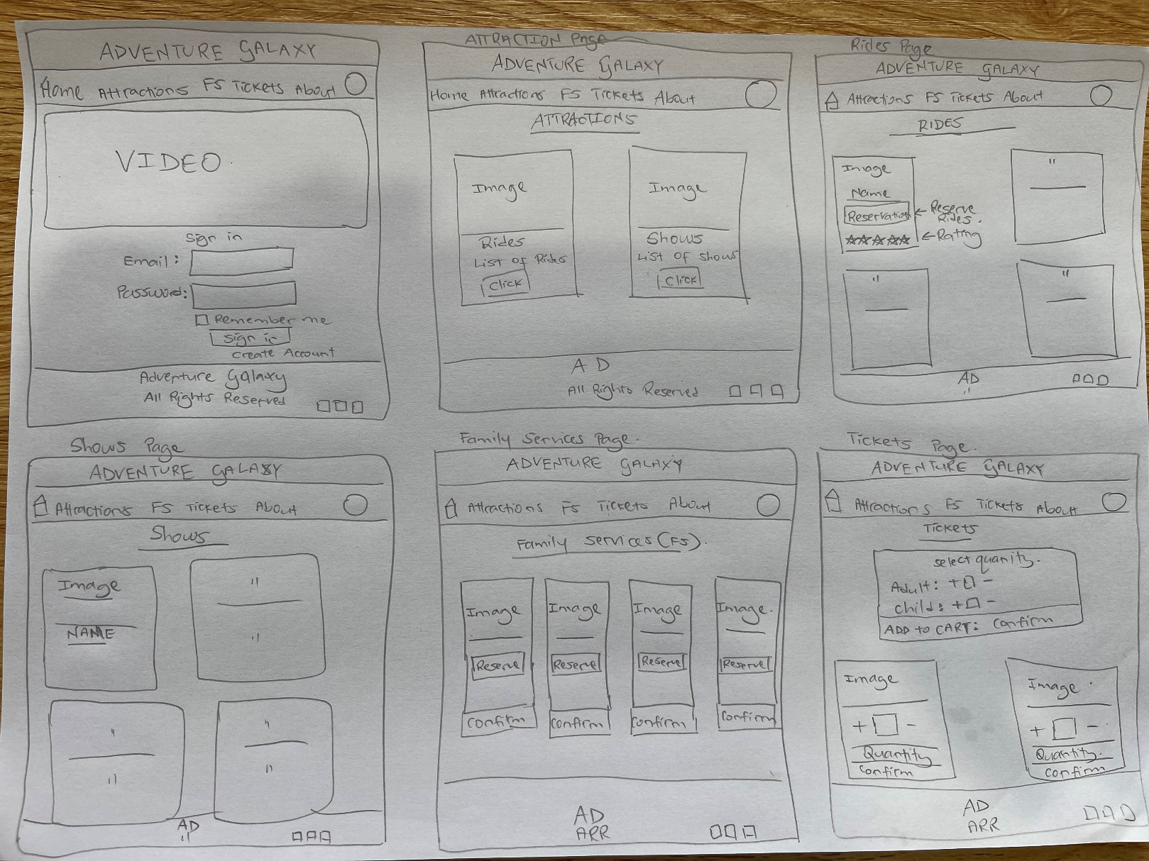
sketch

Slide 18
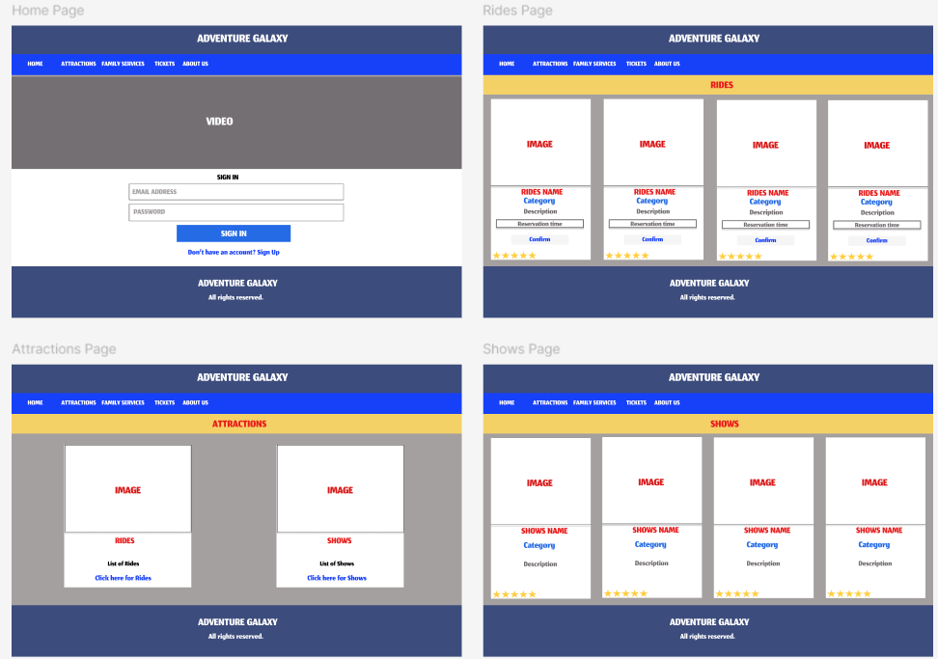
Wireframe Design

Slide 19
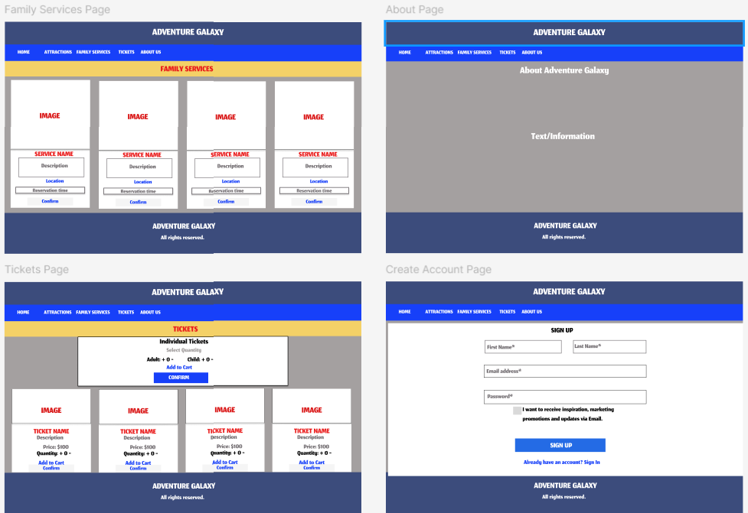
Wireframe design

Slide 20
 | User Story Title | User Story Description | Priority | Additional Notes
1 | Create an Account | As a visitor, I want to create an account so that I can save my preferences and manage my reservations. | Medium | Include options for social media login.
2 | Login to My Account | As a visitor, I want to log in to my account so that I can access my saved preferences and reservations. | Medium | Implement a secure login system.
3 | View Unique Attractions | As a visitor, I want to view the list of unique attractions so that I can decide which ones I want to visit. | High | Include detailed descriptions, images, and videos of each attraction.
4 | Check Real-Time Wait Times | As a visitor, I want to see real-time wait times for each attraction so that I can plan my day efficiently. | High | Display updated wait times prominently on the attraction pages.
5 | Make a Reservation for an Attraction | As a visitor, I want to make reservation for an attraction via the website so that I don't have to physically wait in line. | High | Implement a system to manage reservations and send notifications when it's the user's turn.
6 | Receive Notifications for reminder regarding reservation | As a visitor, I want to receive notifications when it's my turn to ride an attraction so that I can arrive at the ride on time. | High | Notifications should be sent via SMS, email, or push notifications.
7 | View Real-Time Adrenaline Ratings | As a visitor, I want to view real-time adrenaline ratings for rides so that I can choose the most exciting attractions. | High | Display adrenaline ratings alongside ride descriptions.
8 | Rate Ride Experience (Reviews) | As a visitor, I want to rate how good the ride was so that I can share my experience with others. | Medium | Implement a rating system with an adrenaline meter to capture the excitement level of the ride.
9 | Check Height Restrictions | As a visitor, I want to check the height restrictions for each ride so that I can ensure I meet the requirements. | High | Clearly display height restrictions on each ride's page.
10 | View My Reservations | As a visitor, I want to view my reservations so that I can manage my schedule for the day. | High | Include options to edit or cancel reservations.
11 | Purchase Tickets | As a visitor, I want to purchase tickets online so that I can enter the park without having to wait in line at the ticket booth. | High | Include various payment options and send confirmation emails.
12 | Search for Attractions | As a visitor, I want to search for attractions by name or category so that I can find specific rides easily. | High | Implement a robust search functionality.
13 | Contact Customer Support | As a visitor, I want to contact customer support if I encounter any issues so that I can get assistance. | Medium | Provide multiple contact options such as chat, email, and phone.
14 | View and reserve Family Service facilities | As a visitor, I want to view and reserve family service facilities for feeding, changing etc. | High | Provide clear instructions to view and reserve family facilities.

Slide 21
Out of scope
Optimization of Mobile App: Developing or optimizing a mobile application is outside the scope of the website project.
E-commerce Integration: Online store for merchandise and food orders.
Comprehensive User Accounts: Detailed user profiles beyond basic reservation and rating information and user generated content such as photos.
Multilingual Support: Full multilingual website with content available in multiple languages.
Third-party Integrations: Integrations with external travel or accommodation booking services. Partnerships with other local attractions or businesses.
Detailed Accessibility Information: Extensive details on accessibility features for each ride and show. Specific accommodations for visitors with disabilities.
Seasonal and Special Event Pages: Dedicated pages for seasonal events and promotions. Special event booking and management.

Slide 22
Non-functional requirements
Security Requirements:
Authentication and Authorization:
Secure login and registration process.
Multi-factor authentication (MFA) for added security.
Data Protection:
Personal details, including payment information, must be stored securely.
Use encryption for data in transit and at rest.
Implement secure password storage practices (e.g., hashing and salting).
Inactivity Timeout:
Automatic session timeout after a specified period of inactivity (15-30 minutes).
Data Privacy:
Clear privacy policy outlining data usage and user rights.

Slide 23

Non-functional requirements
Performance Requirements:
Transaction Throughput:
The website should handle a high number of transactions during peak times (e.g., 500-1000 transactions per second).
Response Time:
Page load times should be under 2 seconds.
Real-time data (e.g., wait times, notifications) should update within 1 second.
Usability Requirements
Ease of Use:
Should be very easy and user-friendly interface with clear navigation.
Mobile-friendly design for use on smartphones and tablets.
Needs to be easy enough for new staffs if they were newly recruited.

Slide 24
non-functional requirements
Reliability & availability Requirements
The website should have an uptime of at least 99.9%.
Implement redundancy and failover mechanisms to ensure high availability.
Maintainability Requirements
Design the system in a modular fashion to ease updates and maintenance.
Back-End – Uses MVC structure for ease of use.
Front-End – Used proper components, custom hooks for data reuse.
Design the system to easily scale horizontally or vertically to accommodate increased load.

Slide 25
Project planning
DATE | PLANNING | OUTCOME
05/07/2024 | Start Project planning -Decide which project to do -Create GitHub Repository and clone | Done
06/07/2024 | Start documentation -complete Purpose section | Done
07/07/2024 | Documentation -Start and complete Industry/domain section -Start and complete Stakeholders section -Start and complete Open questions/Out of Scope section -Start and complete Non-functional Requirements | -Need to research more on out-of-scope section. -Others Done
08/07/2024 | -Start & complete ‘Sketch ‘ -Start Logical model | -Had to correct/update logical model twice as it had errors.
09/07/2024 | -Complete Logical model -Start & complete Physical model -Start Lo-Fi design | Done
10/07/2024 | -Start and complete Hi-Fi design on Figma. -Do User stories. -Do User Flow diagrams -Tidy up and complete documentation section | Done

Slide 26
Testing strategy
Followed Figma design.
Postman and Thunderclient was used to test CRUD operation for backend and database.
Every component was tested, and errors were resolved.
To Catch errors and odd results, concole.log method was used.

Slide 27

implementation
Considerations for Deployment
Scalability: Ensuring the website can handle a large number of visitors simultaneously, especially during peak times.
Security: Implementing robust security measures to protect user data and prevent unauthorized access.
Performance Optimization: Optimizing the website's performance to ensure fast load times and a smooth user experience.
Backup and Recovery: Setting up regular backups and a recovery plan to prevent data loss.
Compliance: Ensuring the website complies with legal and regulatory requirements, especially regarding data protection and privacy.
Monitoring and Maintenance: Setting up monitoring tools to track the website's performance and implementing a maintenance plan for regular updates and bug fixes.

Slide 28

implementation
Hosting on the Cloud: We will move the website from the local environment to a cloud hosting service. Cloud providers such as AWS, Azure, or Google Cloud offer scalable and reliable hosting solutions.
Domain Registration: Registering a domain name for the website to make it accessible to the public.
Database Integration: Using a cloud-based database service for storing and managing data efficiently.
Load Balancing: Implementing load balancing to distribute traffic evenly across multiple servers, ensuring reliability and availability.
Content Delivery Network (CDN): Using a CDN to deliver content quickly to users based on their geographical location, improving load times and performance.
User Authentication and Authorization: Implementing a secure authentication system to manage user access and protect sensitive information.
Analytics and Reporting: Integrating analytics tools to track user interactions, monitor performance, and gather insights for continuous improvement.

Slide 29

References
The code used in the project can be found in GitHub Rahul-Pala/CapstoneProject (github.com)
A readme file can also be found in the same repository..
React
MUI
React Bootstrap
Nodemon
React Icons
Axios
Express JS
Thunderclient
Postman
MongoDB
Mongoose

Slide 30
demo

